Slide 1
The Intersection of Disability & Climate Change
David Liebmann, M.Ed ‘21 candidate
2020-21 HGSE Sustainability Fellow

Slide 2
Thanks to…
Anne Miller Sargent, HGSE; Sustainability Coordinator, Office for Sustainability, Harvard University
KellyAnn Robinson, HGSE, Associate Director of Student Support Services
Michele Clopper, Director & 504 Coordinator, University Disability Resources
Professor Michael Stein, Executive Director, Harvard Law School Project on Disability (HPOD) + DPI 515 students and speakers

Slide 3
We’re all likely to need a hand.

Slide 4
My background and goals
Studied the environment at Middlebury College, 1991
Taught environmental issues at Chewonki’s Maine Coast Semester
Write about environmental topics for national and regional magazines
Today’s goals: share some research, pose some questions

Slide 5
1989

Slide 6
Summer 2019, over 1400
heat related deaths. Temps from 80-105+ (F)

Slide 7
Climate Change is here…
National Oceanic and Atmospheric Administration satellite image of Hurricane Katrina, taken on August 28, 2005.

Slide 8
According to NASA…
Temperatures will continue to rise
Frost-free Season (and Growing Season) will lengthen
Changes in Precipitation Patterns
More Droughts and Heat Waves
Hurricanes Will Become Stronger and More Intense
Arctic Likely to Become Ice-Free
Sea Level Will Rise 1-8 feet by 2100
(https://climate.nasa.gov/effects)

Slide 9
`
Boston 2019
https://abcnews.go.com/US/video/fire-truck-drives-flooded-boston-street-52148127

Slide 10
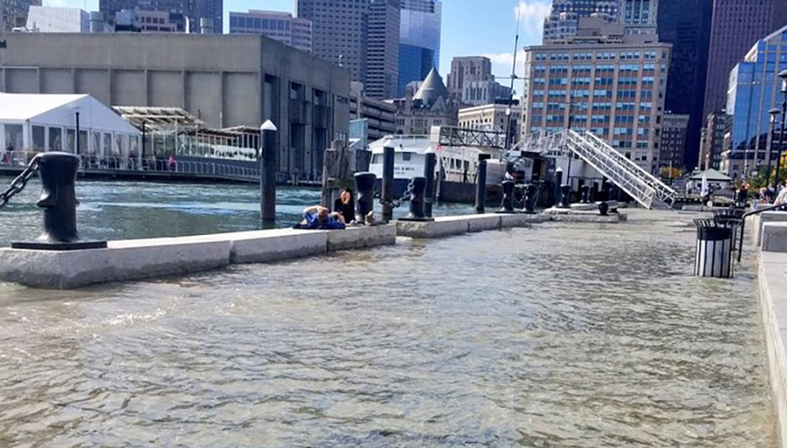
Boston 2019
https://www.boston25news.com/news/noaa-sunny-day-flooding-getting-worse-in-boston/965696868/

Slide 11
The Built Environment Adaptation & Resilience: thinking near and far.
Adams home, Gilchrist, TX after Hurricane Ike, 2005
https://www.cnn.com/2008/US/09/18/ike.last.house.standing/

Slide 12
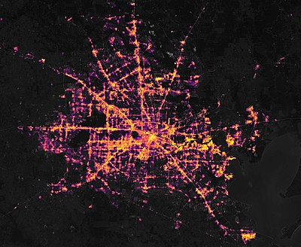
2021 Texas Winter Storm & Electricity
Satellite images of Houston before (2/8) and after (2/16) the storm.^{[1]} The dark patches in the latter image depict areas left without electricity.
https://en.wikipedia.org/wiki/2021_Texas_power_crisis

Slide 13
COVID Lesson: food + necessities

Slide 14
Disability Facts
The WHO estimates that 15% of the global population or 1 billion people have some form of disability (https://www.who.int/news-room/fact-sheets/detail/disability-and-health)
Defining disability: intellectual, physical, visible, invisible. Not one thing, not a unified community, but people with varied histories, stories, challenges, strengths, labels, lack of labels. The gamut of human experience. Intersectional: age, gender, race, economic status, disability.
Not reflected by Google

Slide 15
About 2.7 million wheelchair users in the US, <1% of pop.
https://www.ncbi.nlm.nih.gov/pmc/articles/PMC4397418/

Slide 16
Models of Disability
Medical Model of Disability
Views disability as a problem of the person, directly caused by disease, trauma, or other health condition requiring treatment by medical professionals.
Social Model of Disability
Sees "disability" as a socially created problem requiring social activism and collective action to make modifications for PWD to lead lives.
Identity Model
Shares the social model's understanding that the experience of disability is socially constructed but differs in that it claims disability as a positive identity. Sees abilities rather than disability.
Human Rights Model
Conceives of persons with disabilities as rights bearers, entitled to legal protection against discrimination and to achieve substantive equality with their peers without disabilities.
After https://www.disabled-world.com/definitions/disability-models.php and “ A Disability Rights Approach to Climate Governance” Sébastien Jodoin, Nilani Ananthamoorthy & Katherine Lofts, Ecology Law Journal

Slide 18
United Nations Human Rights Council + United Nations High Commissioner for Human Rights Climate change and the rights of people with disabilities, 2020 “should…”
https://www.ohchr.org/EN/Issues/HRAndClimateChange/Pages/PersonsWithDisabilities.aspx

Slide 21
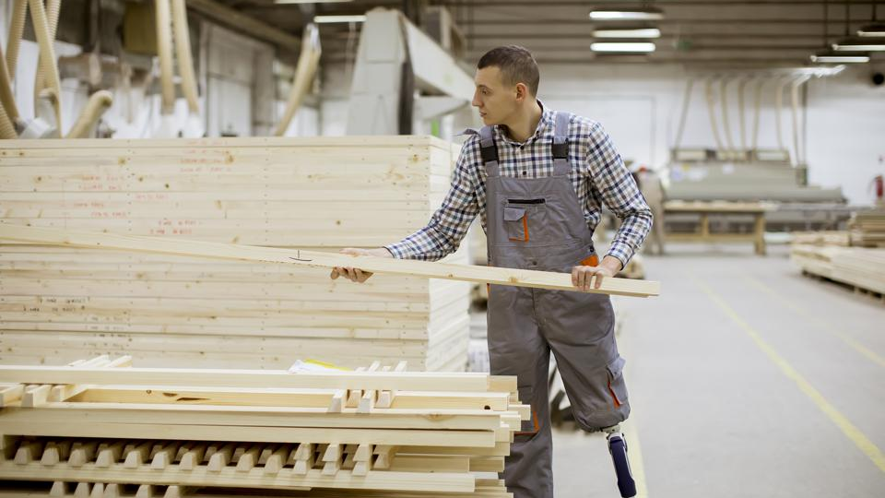
Right to Work: PWD Employment @ 18% in 2020 (Bureau of Labor Statistics)
https://www.forbes.com/sites/sarahkim/2019/10/24/sub-minimum-wages-disability/?sh=4185a1dac22b

Slide 22
https://www.bls.gov/opub/ted/2019/employment-of-people-with-a-disability-in-2018.htm

Slide 23
Snowball Effects
Post COVID, can (disabled) people work from home? Maybe…
People with disabilities already face discrimination and marginalization
Add intersection of disability and poverty:
People with disabilities make up approximately 12 percent of the U.S. working-age population; however, they account for more than half of those living in long-term poverty. (National Council on Disability)
https://ncd.gov/newsroom/2017/disability-poverty-connection-2017-progress-report-release
Add climate emergencies and social and medical support disruption

Slide 24
Right to Transportation
https://dacnw.org/programs-services/transportation-services/

Slide 25
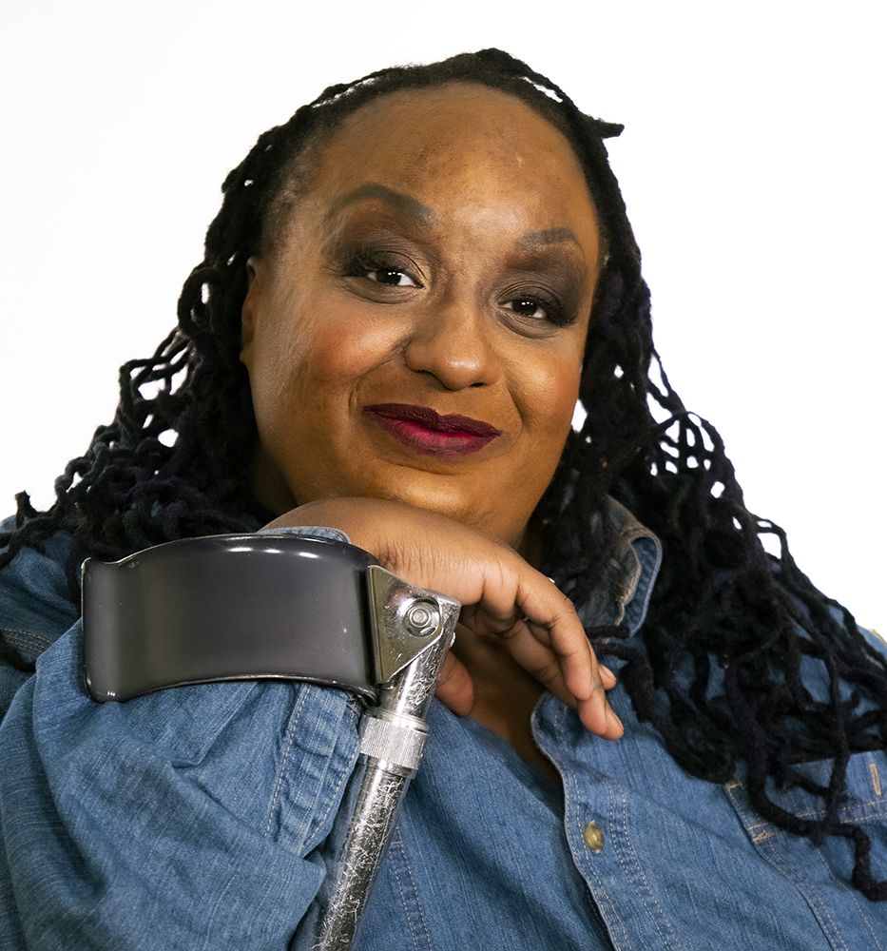
NYC public transportation
NYC Disability Commissioner Victor Calise shared:
100/465 stations accessible
100% bus accessibility
$.5B for paratransit for 160,000 disabled riders
https://www.newmobility.com/2020/05/vote-for-access-tackles-the-barriers-disabled-voters-face/

Slide 26
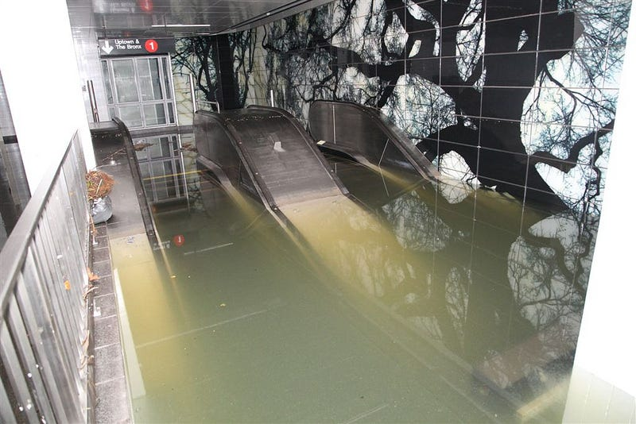
After Hurricane Sandy 2012
https://www.businessinsider.com/hurricane-sandy-photos-of-new-york-subway-flooded-2012-10

Slide 27
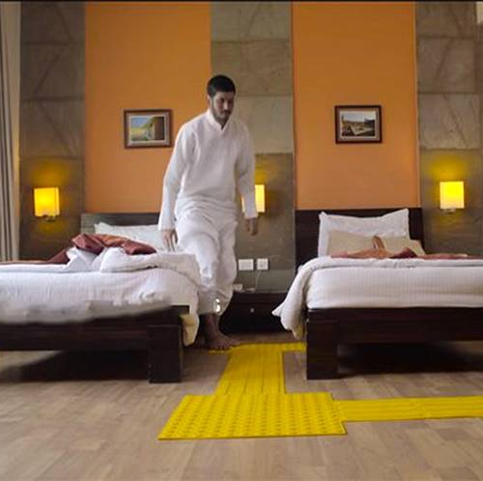
Right to Independent Housing for PWD
https://www.homecrux.com/quick-tips-remodel-home-visually-impaired/12431/

Slide 28
Housing + Low-income housing
Independent living and community inclusion
NYC has 7000 low-income units, but 30,000 PWD on waitlist
www.mercurynews.com%2F2019%2F08%2F28%2Frenters-with-disabilities-sue-oakland-for-housing-discrimination%2F%3FclearUserState%3Dtrue

Slide 29
Climate Displacement – 200 million +/- climate migrants by 2050
30 million PDW may be climate migrants
https://www.hrw.org/news/2017/05/31/south-sudan-people-disabilities-older-people-face-danger

Slide 30
Right to food and water

Slide 31
Disaster Readiness for PWD
Communication
Evacuation
Shelters
Recovery – accessible housing, support networks, healthcare, social services
Katrina, California and Australia Fires, Storms, Power Outages
Conflict refugee planning isn’t necessarily the model; PWD barely mentioned or lumped together with children, elderly
(After Dr. Marsha Saxton, UC Berkeley)

Slide 32
Climate Impacts
250-700 thousand additional deaths due to climate impacts
Disproportionately higher mortality among PWD in climate disasters, including heat waves

Slide 33
Nothing about us without us

Slide 35
Dr. Robert Dubrow, YSPH, Audubon Lecture 2021

Slide 36
The curb cut effect: everyone benefits.

Slide 37
A version of the curb cut effect.

Slide 38
“Nothing about us without us.”
https://www.internationaldisabilityalliance.org/blog/un-committee-rights-persons-disabilities-closes-its-16th-session
UN CRPD https://www.internationaldisabilityalliance.org/blog/un-committee-rights-persons-disabilities-closes-its-16th-session

Slide 39
“Nothing about us without us.”
https://www.wbur.org/news/2021/03/18/alex-gray-blind-boston-city-council-candidate

Slide 40
“Nothing about us without us.”
https://www.huffpost.com/entry/disability-asian-americans-immigrants-stigma_n_5cd1c2c7e4b0548b7360bf26

Slide 41
“Nothing about us without us.”
https://www.nytimes.com/2020/03/07/us/citizenship-exam-blind-man-braille.html

Slide 42
“Nothing about us without us.”
https://www.nytimes.com/2021/01/23/us/black-american-sign-language-tiktok.html

Slide 43
“Nothing about us without us.”
https://www.respectability.org/2019/10/hispanic-heritage-stats/

Slide 44
Be Supportive, Get Involved, Bring Your Resources, Take Action… Together

