Slide 1


Monthly Green Team Meeting
Thursday, April 15, 2021
Notes:
Attendance: Anne Sargent

Slide 2

agenda
Intros & Announcements
Debrief: Sustainability Fellow David Liebmann’s presentation
Up Next: Harvard Sustainability Pledge 2021 for Earth Day
Discussion: What’s next for the Green Team?

Slide 3
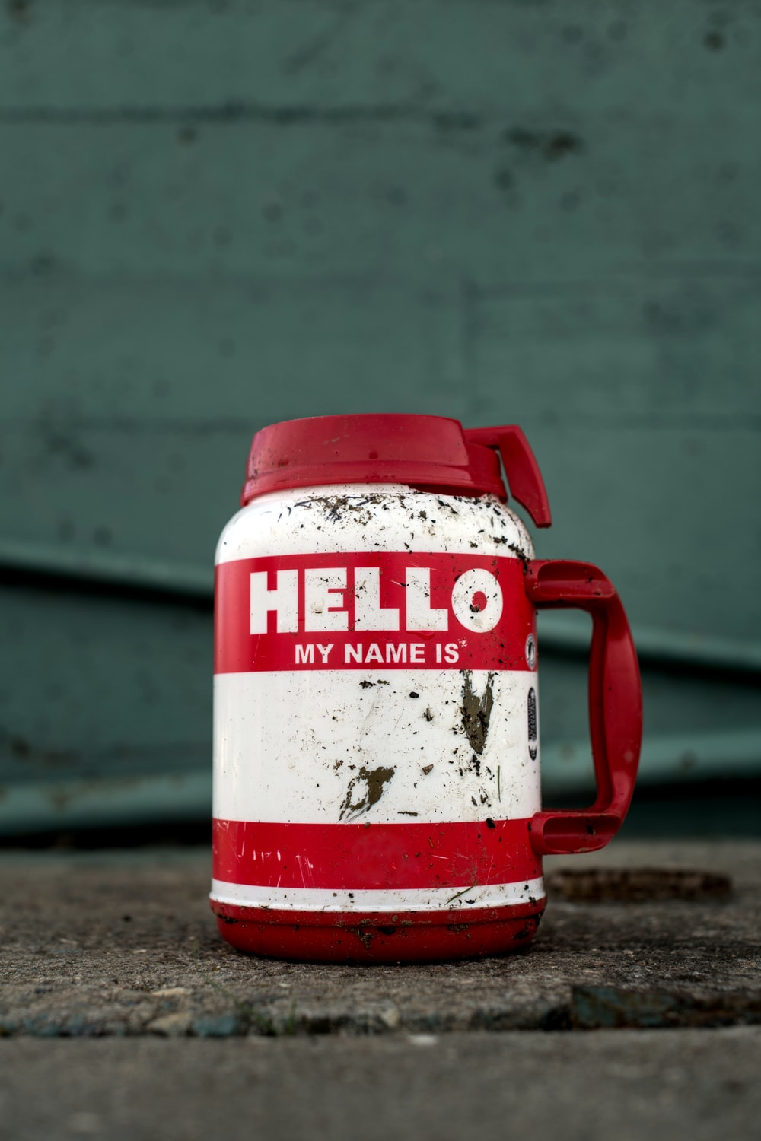

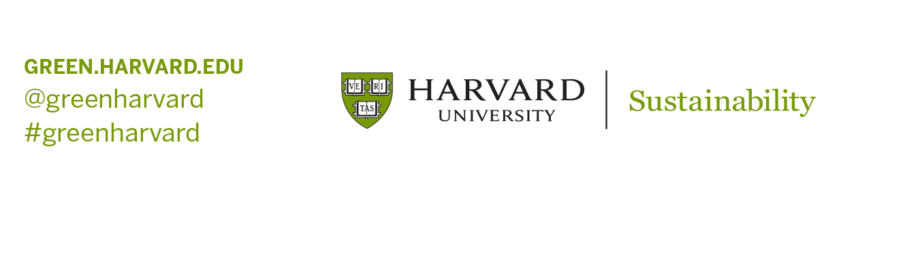
Intro
What is your name and what do you do here at HGSE?
How long have you been involved with the HGSE Green Team?

Slide 4
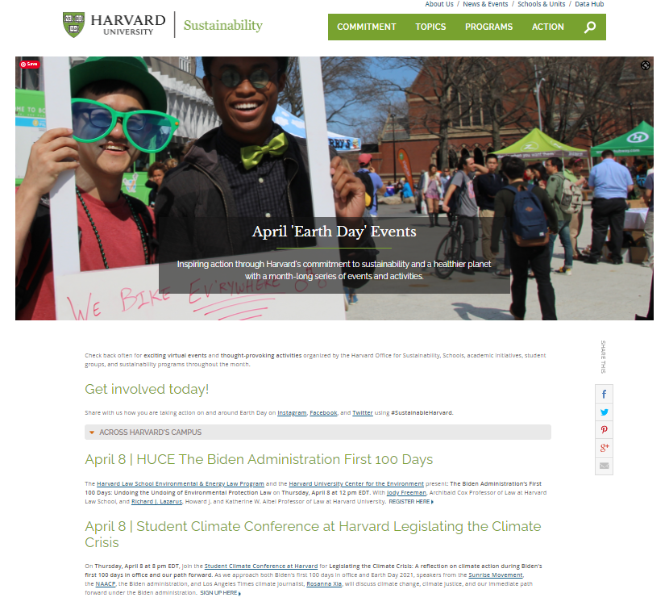
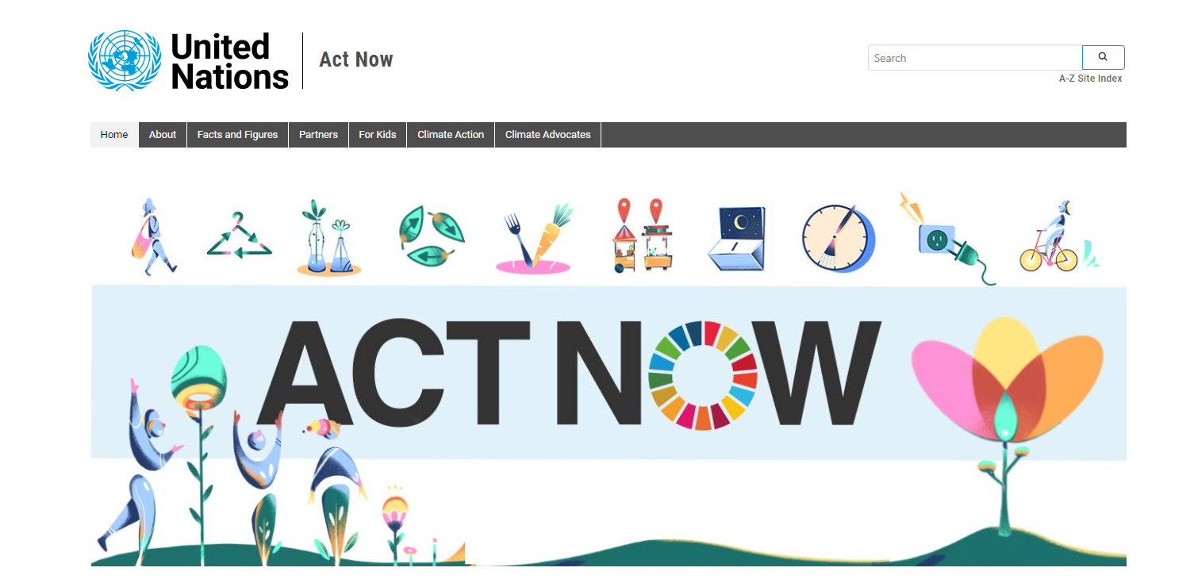

Announcements + Updates
Clean (or dust off) your bike – Wednesday, April 21, 12pm EST, RSVP here
Earth Day! Thursday, April 22
green.harvard.edu/campaign/april-earth-day-events
https://www.un.org/en/actnow
https://www.earthday.org/
Notes:
EARTH DAY – Thursday, April 22, green.harvard.edu/campaign/april-earth-day-events
Celebrate the 51st Earth Day from wherever you are this year:
Commit to one new, more sustainable practice in your life with inspiration from the UN’s ActNow campaign and mobile app.
Contact your elected officials about an environmental issue that moves you.
Sign the Harvard Sustainability Pledge 2021.
Join one of the many events happening this month
Check out earthday.org for even more resources and local activities around the globe.

Slide 5
debrief
What have you been working on? Have you heard any interesting environmental talks lately?
HGSE Sustainability Fellows David Liebmann’s presentation on disability and climate change held on April 1, 2021 at 12pm
Notes:
Sustainability Fellows
https://green.harvard.edu/schools-units/education/hgse-sustainability-fellows
THE INTERSECTION OF DISABILITY AND CLIMATE CHANGE - operations.gse.harvard.edu/hgse-sustainability-fellows
In case you missed it, you can now view HGSE Sustainability Fellow and Ed.M. ’21 candidate David Liebmann’s presentation of his research on the intersection of disability and climate change online. The World Health Organization estimates that Persons with Disabilities (PWD) comprise 15% of the world's population. This newly emerging area of study includes thinking about how to support people with a range of mental and physical disabilities in response to changes in ecosystems worldwide and impacts on the built environment, with PWD community’s mantra “Nothing about us without us” guiding that approach.

Slide 6

Up Next
Day 1 – Tuesday, April 20: Connect with nature
Day 2 – Wednesday, April 21: Start a conversation around sustainability
Day 3 – Thursday, April 22: Be a part of the #GreatGlobalCleanup
Sign the pledge at bit.ly/harvardpledge and
share your progress on social media
#SustainableHarvard and #EarthDay
  green.harvard.edu/events
Notes:
TAKE THE HARVARD SUSTAINABILITY PLEDGE 2021 AND COMMIT TO 3 ACTIONS OVER 3 DAYS - http://bit.ly/harvardpledge
In honor of Earth Day, the HGSE Green Team, the T.H. Chan School’s EcoOpportunity and the Harvard Office for Sustainability are launching a new take on an old campaign: the Harvard Sustainability Pledge 2021. We invite you to pledge to take three actions over three days the week of Earth Day:
Day 1 – Tuesday, April 20: Connect with nature
Day 2 – Wednesday, April 21: Start a conversation around sustainability
Day 3 – Thursday, April 22: Be a part of the #GreatGlobalCleanup
Sign the pledge at http://bit.ly/harvardpledge and then feel free to share your progress on social media using the hashtags #SustainableHarvard and #EarthDay.
HARVARD SUSTAINABILITY PLEDGE 2021 COMMUNICATIONS TOOLKIT
https://drive.google.com/drive/folders/1rB94bGhtbpMo79zLvvKS8l3vQlZoNCtH

Slide 7

Up next
The Harvard Sustainability Pledge 2021
Can you participate?
Could you help spread the word about this event?
Through which channels?
Communications Toolkit

Slide 8
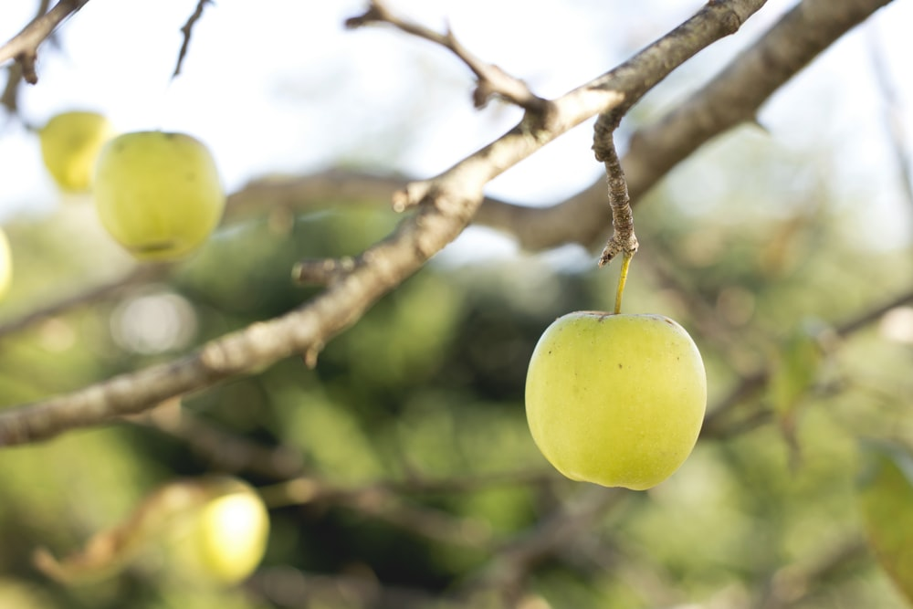
Discussion
What’s next for the HGSE Green Team?
Changing meeting times
What to keep, what to drop ‘post-pandemic’
Committees or working groups, application required
Volunteer term limits

Slide 9

Meeting notes
April 15, 2021 Green Team Meeting
Attendance: Anne Sargent (Operations/Harvard Office for Sustainability)…
See full notes below.
Notes:
April 15, 2021 Green Team Meeting
Meeting Notes
Monthly HGSE Green Team Meeting – Thursday, April 15, 1:00 - 1:45pm EST on Zoom
https://harvard.zoom.us/j/633216113?pwd=QXo0OWFwdjR0SmlCY0NIZlFnR3E0QT09
Password: 021669
April Agenda
Attendance: Rachel Urso (CEPR, Ed.M.'20), Eric Zeckman (Doctoral Programs), Staci Jasin (HGSE Sustainability Fellow, SSP) and Anne Sargent (Office for Sustainability/HGSE Operations)
Intros & Announcements
Rachel shared some big news that she will be leaving HGSE on Friday, April 23 to begin new position at the Harvard Business School. She's been an active member of the HGSE Green Team for five years and has contributed so much over that time, framed by her perspective as both a staff member and an Ed School student. Thank you for your service, Rachel, and best wishes with your new role!
Clean (or dust off) your bike – Wednesday, April 21, 12pm EST, RSVP here
Earth Day! Thursday, April 22
green.harvard.edu/campaign/april-earth-day-events
https://www.un.org/en/actnow
https://www.earthday.org/
Debrief: HGSE Sustainability Fellows updates
Sustainability Fellow David Liebmann’s presentation
THE INTERSECTION OF DISABILITY AND CLIMATE CHANGE - operations.gse.harvard.edu/hgse-sustainability-fellows
In case you missed it, you can now view HGSE Sustainability Fellow and Ed.M. ’21 candidate David Liebmann’s presentation of his research on the intersection of disability and climate change online. The World Health Organization estimates that Persons with Disabilities (PWD) comprise 15% of the world's population. This newly emerging area of study includes thinking about how to support people with a range of mental and physical disabilities in response to changes in ecosystems worldwide and impacts on the built environment, with PWD community’s mantra “Nothing about us without us” guiding that approach.
David Liebmann shared his research and findings on the intersection of climate change and disability at his talk on April 1, which was well attended with 23 people having joined it.
Measuring nature time as we do with screen time
Staci is continuing to work on her project with her coursework this semester and may continue her work into next year as well, since she is a part-time student. She will not be presenting her work this semester.
Up Next: Harvard Sustainability Pledge 2021 for Earth Day
Day 1 – Tuesday, April 20: Connect with nature
Day 2 – Wednesday, April 21: Start a conversation around sustainability
Day 3 – Thursday, April 22: Be a part of the #GreatGlobalCleanup
Sign the pledge at bit.ly/harvardpledge and share your progress on social media #SustainableHarvard and #EarthDay
Help us spread the word using our Communications Toolkit
In addition to this project, Eric suggested that we put together a concise list of our favorite outdoor places in the Boston area, such as a top 10 list, sourced by the HGSE Green Team.
Discussion: What’s next for the Green Team?
Changing meeting times
What to keep, what to drop ‘post-pandemic’
Committees or working groups
Volunteer term limits
What's been good is that meetings are more accessible over Zoom since they don't require people to be in the same place physically and Eric suggested we continue to allow people to join meetings over Zoom by projecting the virtual meeting on the wall of the room where we physically meet for a hybrid meeting experience.
So many things will be different as people gradually return to campus. Eric recommended we see how things develop and then adjust our programming accordingly. For example, mass transit may not be as appealing or feasible for many for a while with the pandemic still around so we may need to switch our messaging around what constitutes green commuting.
Staci asked how the HGSE Green Team is designed versus at other schools. Anne shared that at HKS there are two teams, one with students and one with staff. At HGSE, we have just the one. Staci also brought up how there isn't much synthesis (or coordination thematically) between all the sustainability groups and Green Teams across the University. She has noticed that there isn't a very intentional flow of events.
Anne will share that feedback with the University-wide Office for Sustainability.
We talked about the value of creating committees or even just having people apply to be active members of the Green Team in the same way that students apply to be Sustainability Fellows, with a project in mind that they will independently pursue over the course of the academic year. We would need to come up with a name for this role and will discuss it further at the May meeting.
We talked as well about how orientation is a really critical piece in terms of the Green Team's opportunity to educate the community and especially the student body. We can get to work on orientation in May/June.
Anne will check in with HGSE Operations in April and with Kevin Boehm at OSA in late May about what format this could take.
Staci lastly shared that she and David Liebmann have reached out to the Dean's Office about starting a sustainability center of some sorts at HGSE, which Anne has encouraged, so the Ed School can start to incorporate sustainability into academics more systematically.

